Slide 1

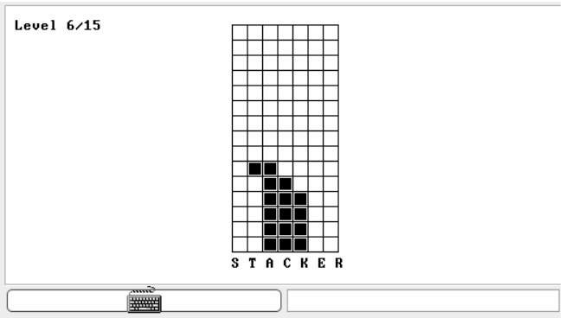
21AIE112
ELEMENTS OF COMPUTING SYSTEMS - 2
STACKER - GAME
Team Members
BL.EN.U4AIE21015 : SAI ABHISHEK
BL.EN.U4AIE21017 : RUCHITH BALAJI
BL.EN.U4AIE21038 : CHILLAKURU HARI
Dept. of AIE ASE,BANGLORE
1

Slide 2
Contents
Abstract
About The Game
Detailed Description
INSTRUCTIONS
Output of Game
Conclusion
Dept. of AIE ASE,BANGLORE

Slide 3
ABSTRACT
The STACKER game is totally written JACK language.
To run the game in VM Emulator.
A Player can stop the Moving Row Horizontally by pressing the SPACEBAR and place it on the Top of the Layer.
When the Player places 15 layers continuously…Then the player Wins!! And the game restarts.
Dept. of AIE ASE,BANGLORE

Slide 4
ABOUT THE GAME
Stacker is an arcade game where the goal is to build a stack of
blocks as high as possible.
Stacker game contains 15 Levels.
At each level, a row of blocks moves sideways and the user has
to lock the blocks in place.
And timing it so that it aligns with the previous level.
Blocks that don't align are lost and if no blocks aligned at all, the
player loses.
As the levels increase, the blocks move faster making timing
even more critical.
Dept. of AIE ASE,BANGLORE

Slide 5
Jack Programming Language
ABOUT THE GAME
Jack is a object based language like Java
It is a multipurpose language and a high level language
Can be used to write complex programs like Operating System
Uses methods , constructors and functions
Can create complex data structures like lists , trees
Dept. of AIE ASE,BANGLORE

Slide 6
Jack Programming Language
ABOUT THE GAME
Screen is divided into 256 rows and 512 columns
The screen left top most corner starts from (0,0), right end corner (511,255)
Screen.drawRectangle(x1,x2,y1,y2)- (x1,x2)&(y1,y2) are coordinates of diagonals of rectangle
Screen.drawLine(x1,x2,y1,y2)- (x1,x2)&(y1,y2) are coordinates of ends of lines
Sys.wait(x) – For delaying for few seconds
Screen.setColor(false) –sets screen to white
Screen.setColor(true) –sets screen to black
Dept. of AIE ASE,BANGLORE

Slide 7
Built-in Functions
Output.printString()- To print a string
Keyboard.keypressed()-returns the key pressed
Screen.drawPixel(x,y) -x:row,y:column
Memory.poke(x,y) – does 16 memory write operations starting from x bit in y column
Memory.deAlloc(this)- to deallocate the memory and recycle
Keyboard.readLine()/Keyboard.readInt() to take input from user
Dept. of AIE ASE,BANGLORE

Slide 8
Used Jack Files(Detailed Description)
In this game we have used 7 jack files to Run:
Stacker.jack
Constants.jack
Drawer.jack
Stack.jack
MovingRow.jack
Stackergame.jack
Main.jack
Dept. of AIE ASE,BANGLORE

Slide 9
Stacker.jack
This jack file creates a Start page for player to proceed.
In this File Constructer Stacker is used.
An array of length is initialised to print the Commands or Menu for player to proceed further.
Two keys are used with appropriate method to start and Quit the game.
Takes the User Input from player and corresponding work with assigned key will be done

Slide 10
Constants.jack
In this file 5 functions to perform the play and quit Operations on the Start Menu.
The functions are COLS , LEVELS , KEY_SPACE , KEY_P , KEY_Q.
KEY_P = Starts the game ; KEY_Q = Quits the game
Drawer.jack
This file Draws a grid with Built-in methods where the stacker game is to be performed.
This file also draws the Row which is to played during the Game.

Slide 11
Stack.jack
In this file a Constructer is created With named as Stack.
And Initialised the array for Creating the Required levels.
Adds a new row to the stack, keeping only blocks that are stackable.
Main.jack
Creates a new Stacker game.
Stacker is disposed.

Slide 12
MovingRow.jack
Implements the row that moves sideways.
In this File set the number of blocks (aBlocks) starting from index (offset) in the row.
Sets the moving speed and block starting position according to the new level
Set the speed of the blocks given a level.
Determines whether to move the blocks and where to move them

Slide 13
Stackergame.jack
Implements a stacker game.
Stacker is an arcade game where the goal is to build a stack of blocks as high as possible. At each level, a row of blocks moves sideways.
The user has to lock the blocks in place (using the SPACE key) and timing it so that it aligns with the previous level.
Blocks that don’t align are lost and if no blocks aligned at all, the player loses.
As the levels increase, the blocks move faster making timing even more critical.
Acts as the controller between moving the row, updating the stack, the game state and drawing to screen.

Slide 14
INSTRUCTIONS
Input Keys at Interface :
The Following input keys are required to perform this game successfully.
In Game:
Only SPACE key is required in the Game
Key | Function
P | Starts the Game
Q | Quits the Game
Key | Function
Space | Locks the Blocks
Dept. of AIE ASE,BANGLORE

Slide 15
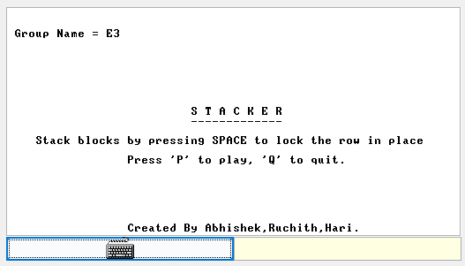
OUTPUT
INTERFACE(At Start)
Dept. of AIE ASE,BANGLORE

Slide 16
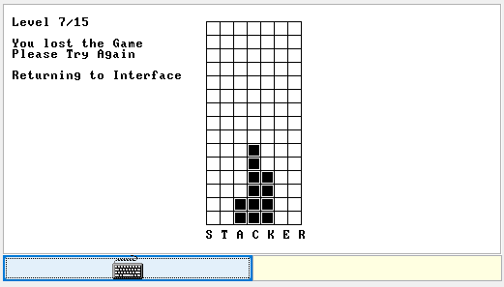
OUTPUT
INTERFACE(At End)
Case-1 If Player Loses the Game
Dept. of AIE ASE,BANGLORE

Slide 17
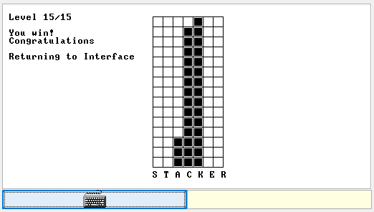
OUTPUT
INTERFACE(At End)
Case-2 If Player Wins the Game
Dept. of AIE ASE,BANGLORE

Slide 18
THANK YOU
Dept. of AIE ASE,BANGLORE

